Slide 1
Case Study Title
CRM CASE STUDY

Slide 2
Name
Personal Info
Etc.

Slide 3
Question Policy

Slide 4
Overview
Objectives
Critical Skills Review
Case Study Focus Skill
Synopsis
Focus Questions

Slide 5
Objectives
Terminal Objective
Enabling Objective

Slide 6
Crew Resource Management
Allows crew to interact effectively while performing mission tasks
A program to effect behavior modifications in order to prevent human factor and crew preventable errors
To improve mission effectiveness through increased awareness of associated behavioral skills
What does CRM mean to me?

Slide 7
CRM Critical Skills Review
Decision Making (DM)
Assertiveness (AS)
Mission Analysis (MA)
Communication (CM)
Leadership (LD)
Adaptability/Flexibility (AF)
Situational Awareness (SA)

Slide 8
Case Study Focus Skill
MISSION ANALYSIS
The ability to develop short term, long term, and contingency plans and to coordinate, allocate, and monitor crew and resources.
Effective planning leads to less uncertainty, increases mission effectiveness, and enhances safety.

Slide 9
Three Phases
Pre-mission organizing and planning
In-flight monitoring and updating
Post-mission review

Slide 10
Pre-Mission Analysis
Identifying Mission Objectives
Identifying Mission Constraints, Restraints, and Options
Flight Preparation
Identify Contingency Plans
Advise crew of what to ecpect
Briefing

Slide 11
Effective Brief Traits
Planned and practiced in advance
Professional/Organized
Focused/On-track
Assigns responsibilities
Interactive
Complete/Thorough
Allows time for questions and clarifications of ambiguities

Slide 12
In-Flight Mission Analysis
Critiques and updates existing plans
Evaluates results of previous decisions
Informs the crew of changes to flight concept

Slide 13
Post-Mission Analysis
Critiques entire mission
Determines areas for future improvement
Interactive
Timely
Honest
Organized/community accepted outline

Slide 14
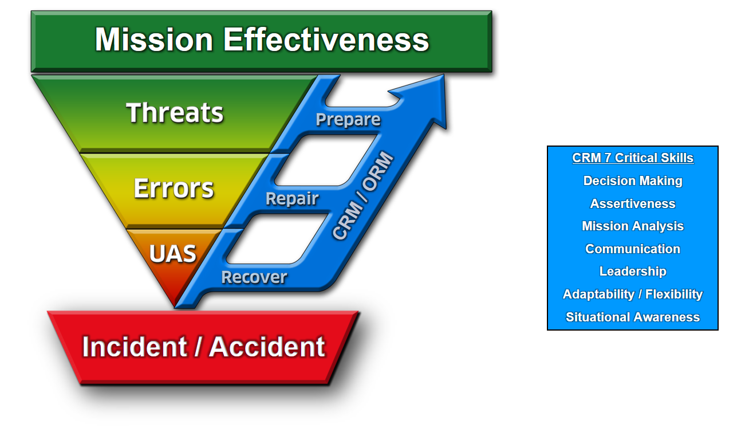
Threat and Error Management
TEM is what we do. CRM is how we do it.
Notes:
MASTER TEM SLIDE

Slide 15
Why Threat & Error Management?
In the past: We focused on eliminating human error in aviation.
Contemporary acknowledgement: Errors are inevitable, so…
We must instead focus on ways to effectively MANAGE and REDUCE errors

Slide 16
Mission Effectiveness
MISSION EFFECTIVENESS

Slide 17
Mission Effectiveness
MISSION EFFECTIVENESS
What is a mission?

Slide 18
Mission Effectiveness
MISSION EFFECTIVENESS
A Mission is the Task + Purpose

Slide 19
Mission Effectiveness
MISSION EFFECTIVENESS
How is Effectiveness defined?

Slide 20
Mission Effectiveness
MISSION EFFECTIVENESS
How is Effectiveness defined?
Completing the task to specific standards:
Time / Cost / Quality

Slide 21
Mission Effectiveness
MISSION EFFECTIVENESS
Mission Effectiveness is completing the task to specific standards in order to fulfill the purpose.

Slide 22
Mission
MISSION EFFECTIVENESS
Task + Purpose

Slide 23
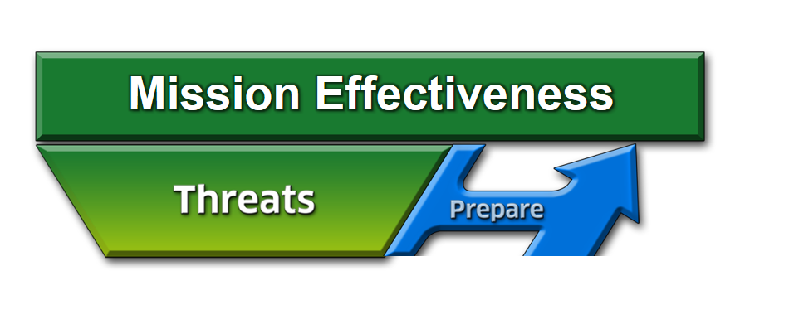
Threats
A THREAT is anything that increases operational complexity that, if not managed properly, can decrease the safety margins.

Slide 24
Threats
How do we operate in spite of the fact that we cannot eliminate the THREATS from aviation?
Effectively PREPARE for and manage them
24 of 20
Notes:
24

Slide 25
Threats
What is our strategy to manage threats?
Identify and PREPARE

Slide 26
Strategies to Prepare for Threats
Things we can use to counter threats:
ORM
Clearly defined roles of aircrew members
Complete briefing and effective communication
Limit being “heads down” at critical times
NATOPS / System Knowledge
CRM
Notes:
26

Slide 27
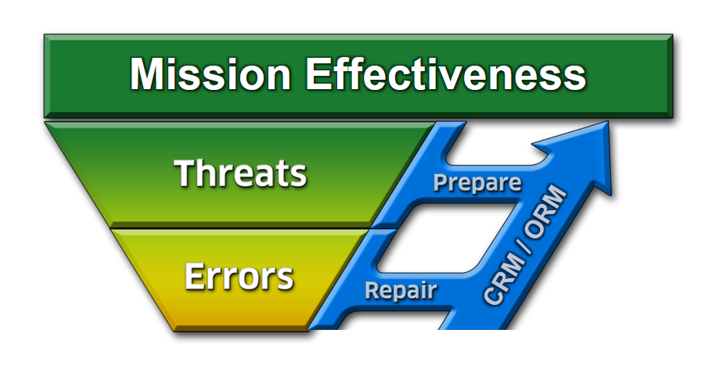
Errors
What can happen if we ignore or mismanage a THREAT?
27 of 20

Slide 28
Definition of Error
Error:
Crew action or inaction that leads to deviations from expectations and reduces safety margins
May occur from either mistakes or mismanaged threats
Error Management:
Process of correcting an error before it becomes consequential, i.e. Undesired Aircraft State and Incident/Accident
Notes:
28

Slide 29
Categories of Errors
Procedural - Following procedures but wrong execution (wrong altitude on course rules)
Communication - Missing info or misinterpretation (miscommunication with ATC)
Proficiency - Error due to a lack of knowledge/currency (night TERF/DVE landings)
Decision - Crew decision unbounded by procedures that unnecessarily increased risk (unnecessary navigation through adverse wx)
Intentional Noncompliance - Violations (AOB exceedances)
Notes:
29

Slide 30
Strategies for Errors
What is our strategy to manage errors?
CRM 7 Critical Skills
Decision Making
Assertiveness
Mission Analysis
Communication
Leadership
Adaptability / Flexibility
Situational Awareness
Identify and REPAIR
30 of 20

Slide 31
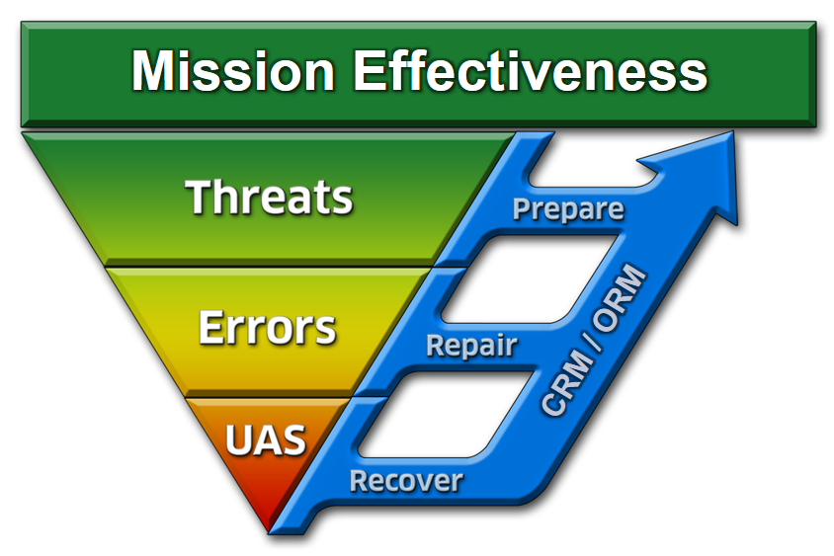
What if We Don’t Repair the Error?
Undesired Aircraft State: A position, speed, attitude, condition, or configuration of an aircraft that reduces safety margins.
31 of 20

Slide 32
How to Manage an Undesired Aircraft State
Identify and RECOVER
Notes:
32

Slide 33
PRIVILEGED
FOR OFFICIAL USE ONLY
THIS IS A PRIVILEGED, LIMITED-USE, LIMITED-DISTRIBUTION, SAFETY INVESTIGATION REPORT. UNAUTHORIZED DISCLOSURE OF THE INFORMATION IN THIS REPORT OR ITS SUPPORTING ENCLOSURES BY MILITARY PERSONNEL IS A CRIMINAL OFFENSE PUNISHABLE UNDER ARTICLE 92, UNIFORM CODE OF MILITARY JUSTICE. UNAUTHORIZED DISCLOSURE OF THE INFORMATION IN THIS REPORT OR ITS SUPPORTING ENCLOSURES BY CIVILIAN PERSONNEL WILL SUBJECT THEM TO DISCIPLINARY ACTION UNDER CIVILIAN PERSONNEL INSTRUCTION 752. THIS REPORT MAY NOT BE RELEASED, IN WHOLE OR IN PART, EXCEPT BY THE COMMANDER, NAVAL SAFETY CENTER.

Slide 34
Synopsis

Slide 35
Threat and Error Management
TEM is what we do. CRM is how we do it.
Notes:
MASTER TEM SLIDE

Slide 36
Focus Questions
What threats came “at” the crew and what strategies were used to prepare for threats and initially deal with them?
What errors came “from” the crew and how did they use mission analysis to repair the errors?
What undesired aircraft state was achieved and how did the crew recover?

Slide 37
Mission Effectiveness
MISSION EFFECTIVENESS
What is the mission?

Slide 38
Focus Question #1
What threats came “at” the crew and what strategies were used to prepare for threats and initially deal with them?

Slide 39
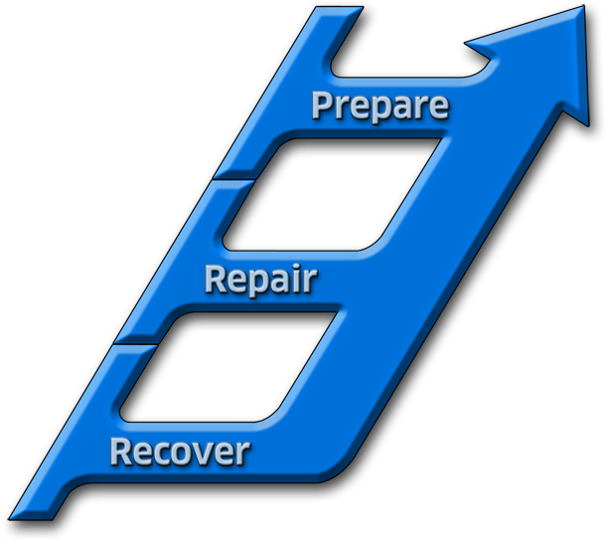
Focus Question #2
What errors came “from” the crew and how did they use MA to repair the errors?
Mission Effectiveness
CRM 7 Critical Skills
Decision Making
Assertiveness
Mission Analysis
Communication
Leadership
Adaptability / Flexibility
Situational Awareness
CRM / ORM
Identify and REPAIR
Notes:
MASTER TEM SLIDE

Slide 40
Focus Question #3
What Undesired Aircraft State was achieved and how did the crew recover?

Slide 41
Remember
Mission analysis is a crew effort – how well you coordinate actions can make a difference
Each stage of mission analysis has an impact on the overall mission
Failure to develop a good plan, or to revise a plan when the situation changes, can result in a failed mission or a mishap

Slide 42
Questions?

Slide 43
Mission Effectiveness
CRM 7 Critical Skills
Decision Making
Assertiveness
Mission Analysis
Communication
Leadership
Adaptability / Flexibility
Situational Awareness
CRM / ORM
Incident / Accident
Notes:
MASTER TEM SLIDE

